Slide 1
Mining Massive Datasets
Wu-Jun Li
Department of Computer Science and Engineering
Shanghai Jiao Tong University
Lecture 3: Frequent Itemsets and Association Rules

Slide 2
Outline
Association rules
A-Priori algorithm
Large-scale algorithms

Slide 3
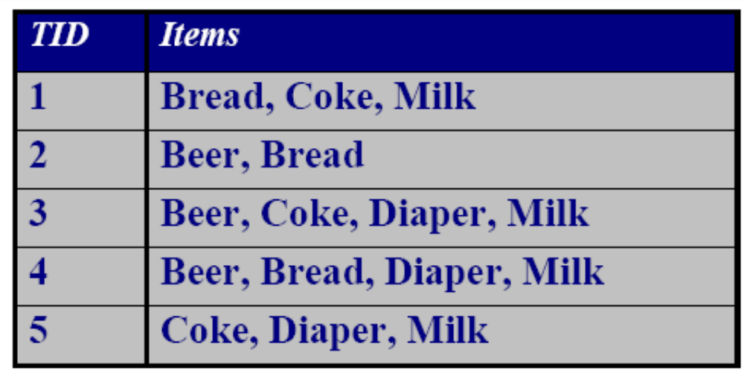
The Market-Basket Model
Association Rules
A large set of items, e.g., things sold in a supermarket.
A large set of baskets, each of which is a small set of the items, e.g., the things one customer buys on one day.

Slide 4
Market-Baskets – (2)
Association Rules
Really a general many-many mapping (association) between two kinds of things.
  But we ask about connections among “items,” not “baskets.”
The technology focuses on common events, not rare events (“long tail”).

Slide 5
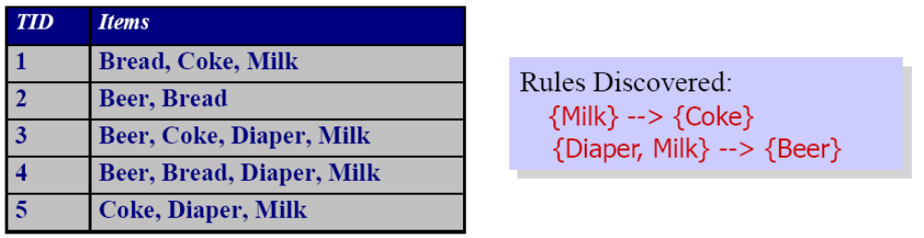
Association Rule Discovery
Association Rules
Goal: To identify items that are bought together by sufficiently many customers, and find dependencies among items

Slide 6
Support
Association Rules
Simplest question: find sets of items that appear “frequently” in the baskets.
Support for itemset I = the number of baskets containing all items in I.
  Sometimes given as a percentage.
Given a support threshold s, sets of items that appear in at least s baskets are called frequent itemsets.

Slide 7
Example: Frequent Itemsets
Association Rules
Items={milk, coke, pepsi, beer, juice}.
Support threshold = 3 baskets.
  B₁ = {m, c, b} B₂ = {m, p, j}
  B₃ = {m, b} B₄ = {c, j}
  B₅ = {m, p, b} B₆ = {m, c, b, j}
  B₇ = {c, b, j} B₈ = {b, c}
Frequent itemsets: {m}, {c}, {b}, {j},
{m,b}
, {b,c}
, {c,j}.

Slide 8
Applications – (1)
Association Rules
Items = products; baskets = sets of products someone bought in one trip to the store.
Example application: given that many people buy beer and diapers together:
  Run a sale on diapers; raise price of beer.
Only useful if many buy diapers & beer.

Slide 9
Applications – (2)
Association Rules
Baskets = sentences; items = documents containing those sentences.
Items that appear together too often could represent plagiarism.
Notice items do not have to be “in” baskets.

Slide 10
Applications – (3)
Association Rules
Baskets = Web pages; items = words.
Unusual words appearing together in a large number of documents, e.g., “Brad” and “Angelina,” may indicate an interesting relationship.

Slide 11
Scale of the Problem
Association Rules
WalMart sells 100,000 items and can store billions of baskets.
The Web has billions of words and many billions of pages.

Slide 12
Association Rules
Association Rules
If-then rules about the contents of baskets.
{i₁, i₂,…,i_{k}} → j means: “if a basket contains all of i₁,…,i_{k} then it is likely to contain j.”
Confidence of this association rule is the probability of j given i₁,…,i_{k}.

Slide 13
Example: Confidence
Association Rules
  B₁ = {m, c, b} B₂ = {m, p, j}
  B₃ = {m, b} B₄ = {c, j}
  B₅ = {m, p, b} B₆ = {m, c, b, j}
  B₇ = {c, b, j} B₈ = {b, c}
An association rule: {m, b} → c.
  Confidence = 2/4 = 50%.
+
_
_
+

Slide 14
Finding Association Rules
Association Rules
Question: “find all association rules with support ≥ s and confidence ≥ c .”
  Note: “support” of an association rule is the support of the set of items on the left.
Hard part: finding the frequent itemsets.
  Note: if {i₁, i₂,…,i_{k}} → j has high support and confidence, then both {i₁, i₂,…,i_{k}} and {i₁, i₂,…,i_{k} ,j } will be “frequent.”

Slide 15
Computation Model
Association Rules
Typically, data is kept in flat files rather than in a database system.
  Stored on disk.
  Stored basket-by-basket.
  Expand baskets into pairs, triples, etc. as you read baskets.
    Use k nested loops to generate all sets of size k.

Slide 16
File Organization
Association Rules
Item
Item
Example: items are
positive integers,
and boundaries
between baskets
are –1.
Item
Basket 1
Item
Item
Item
Item
Basket 2
Item
Item
Item
Basket 3
Item
Item
Etc.

Slide 17
Computation Model – (2)
Association Rules
The true cost of mining disk-resident data is usually the number of disk I/O’s.
In practice, association-rule algorithms read the data in passes – all baskets read in turn.
Thus, we measure the cost by the number of passes an algorithm takes.

Slide 18
Main-Memory Bottleneck
Association Rules
For many frequent-itemset algorithms, main memory is the critical resource.
  As we read baskets, we need to count something, e.g., occurrences of pairs.
  The number of different things we can count is limited by main memory.
  Swapping counts in/out is a disaster (why?).

Slide 19
Finding Frequent Pairs
Association Rules
The hardest problem often turns out to be finding the frequent pairs.
  Why? Often frequent pairs are common, frequent triples are rare.
    Why? Probability of being frequent drops exponentially with size; number of sets grows more slowly with size.
We’ll concentrate on pairs, then extend to larger sets.

Slide 20
Naïve Algorithm
Association Rules
Read file once, counting in main memory the occurrences of each pair.
  From each basket of n items, generate its n (n -1)/2 pairs by two nested loops.
Fails if (#items)² exceeds main memory.
  Remember: #items can be 100K (Wal-Mart) or 10B (Web pages).

Slide 21
Example: Counting Pairs
Association Rules
Suppose 10⁵ items.
Suppose counts are 4-byte integers.
Number of pairs of items: 10⁵(10⁵-1)/2 = 5*10⁹ (approximately).
Therefore, 2*10¹⁰ (20 gigabytes) of main memory needed.

Slide 22
Details of Main-Memory Counting
Association Rules
Two approaches:
  (1) Count all pairs, using a triangular matrix.
  (2) Keep a table of triples [i, j, c] = “the count of the pair of items {i, j } is c.”
(1) requires only 4 bytes/pair.
  Note: always assume integers are 4 bytes.
(2) requires 12 bytes, but only for those pairs with count > 0.

Slide 23
Association Rules
Details of Main-Memory Counting
4 bytes per pair
12 bytes per
occurring pair
Method (1)
Method (2)

Slide 24
Triangular-Matrix Approach – (1)
Association Rules
Number items 1, 2,…
  Requires table of size O(n) to convert item names to consecutive integers.
Count {i, j } only if i < j.
Keep pairs in the order {1,2}, {1,3},…, {1,n }, {2,3}, {2,4},…,{2,n }, {3,4},…, {3,n },…{n -1,n }.

Slide 25
Triangular-Matrix Approach – (2)
Association Rules
Find pair {i, j } at the position (i –1)(n –i /2) + j – i.
Total number of pairs n (n –1)/2; total bytes about 2n ².

Slide 26
Details of Approach #2
Association Rules
Total bytes used is about 12p, where p is the number of pairs that actually occur.
  Beats triangular matrix if at most 1/3 of possible pairs actually occur.
May require extra space for retrieval structure, e.g., a hash table.

Slide 27
Outline
Association rules
A-Priori algorithm
Large-scale algorithms

Slide 28
A-Priori Algorithm – (1)
A-Priori Algorithm
A two-pass approach called a-priori limits the need for main memory.
Key idea: monotonicity : if a set of items appears at least s times, so does every subset.
  Contrapositive for pairs: if item i does not appear in s baskets, then no pair including i can appear in s baskets.

Slide 29
A-Priori Algorithm – (2)
A-Priori Algorithm
Pass 1: Read baskets and count in main memory the occurrences of each item.
  Requires only memory proportional to #items.
Items that appear at least s times are the frequent items.

Slide 30
A-Priori Algorithm – (3)
A-Priori Algorithm
Pass 2: Read baskets again and count in main memory only those pairs both of which were found in Pass 1 to be frequent.
  Requires memory proportional to square of frequent items only (for counts), plus a list of the frequent items (so you know what must be counted).

Slide 31
Picture of A-Priori
A-Priori Algorithm
Item counts
Frequent items
Counts of
pairs of
frequent
items
Pass 1
Pass 2

Slide 32
Detail for A-Priori
A-Priori Algorithm
You can use the triangular matrix method with n = number of frequent items.
  May save space compared with storing triples.
Trick: number frequent items 1,2,… and keep a table relating new numbers to original item numbers.

Slide 33
A-Priori Using Triangular Matrix for Counts
A-Priori Algorithm
Item counts
1. Freq- Old
2. quent item
… items #’s
Counts of
pairs of
frequent
items
Pass 1
Pass 2

Slide 34
A-Priori for All Frequent Itemsets
A-Priori Algorithm
For each k, we construct two sets of k -sets (sets of size k ):
  C_{k} = candidate k -sets = those that might be frequent sets (support > s ) based on information from the pass for k –1.
  L_{k} = the set of truly frequent k -sets.

Slide 35
A-Priori Algorithm
A-Priori for All Frequent Itemsets
Count
the items
All pairs
of items
from L₁
Count
the pairs
All
items
To be
explained
Filter
Construct
Filter
Construct
C₁
L₁
C₂
L₂
C₃
First
pass
Second
pass
Frequent
items
Frequent
pairs

Slide 36
A-Priori for All Frequent Itemsets
A-Priori Algorithm
One pass for each k.
Needs room in main memory to count each candidate k -set.
For typical market-basket data and reasonable support (e.g., 1%), k = 2 requires the most memory.

Slide 37
A-Priori for All Frequent Itemsets
A-Priori Algorithm
C₁ = all items
In general, L_{k} = members of C_{k} with support ≥ s.
C_{k +1} = (k +1) -sets, each k of which is in L_{k} .

Slide 38
Outline
Association rules
A-Priori algorithm
Large-scale algorithms

Slide 39
PCY Algorithm
Large-Scale Algorithms
During Pass 1 of A-priori, most memory is idle.
Use that memory to keep counts of buckets into which pairs of items are hashed.
  Just the count, not the pairs themselves.

Slide 40
PCY Algorithm
Large-Scale Algorithms
Pairs of items need to be generated from the input file; they are not present in the file.
We are not just interested in the presence of a pair, but we need to see whether it is present at least s (support) times.

Slide 41
PCY Algorithm
Large-Scale Algorithms
A bucket is frequent if its count is at least the support threshold.
If a bucket is not frequent, no pair that hashes to that bucket could possibly be a frequent pair.
On Pass 2, we only count pairs that hash to frequent buckets.

Slide 42
Picture of PCY
Large-Scale Algorithms
Hash
table
Item counts
Frequent items
Bitmap
Counts of
candidate
pairs
Pass 1
Pass 2

Slide 43
PCY Algorithm
Large-Scale Algorithms
Space to count each item.
  One (typically) 4-byte integer per item.
Use the rest of the space for as many integers, representing buckets, as we can.

Slide 44
PCY Algorithm – Pass 1
Large-Scale Algorithms
FOR (each basket) {
FOR (each item in the basket)
add 1 to item’s count;
FOR (each pair of items) {
hash the pair to a bucket;
add 1 to the count for that bucket
}
}

Slide 45
PCY Algorithm
Large-Scale Algorithms
A bucket that a frequent pair hashes to is surely frequent.
  We cannot use the hash table to eliminate any member of this bucket.
Even without any frequent pair, a bucket can be frequent.
  Again, nothing in the bucket can be eliminated.
3. But in the best case, the count for a bucket is less than the support s.
  Now, all pairs that hash to this bucket can be eliminated as candidates, even if the pair consists of two frequent items.
Thought question: under what conditions can we be sure most buckets will be in case 3?

Slide 46
PCY Algorithm – Between Passes
Large-Scale Algorithms
Replace the buckets by a bit-vector:
  1 means the bucket is frequent; 0 means it is not.
4-byte integers are replaced by bits, so the bit-vector requires 1/32 of memory.
Also, decide which items are frequent and list them for the second pass.

Slide 47
PCY Algorithm – Pass 2
Large-Scale Algorithms
Count all pairs {i, j } that meet the conditions for being a candidate pair:
  Both i and j are frequent items.
  The pair {i, j }, hashes to a bucket number whose bit in the bit vector is 1.
Notice all these conditions are necessary for the pair to have a chance of being frequent.

Slide 48
PCY Algorithm
Large-Scale Algorithms
Buckets require a few bytes each.
  Note: we don’t have to count past s.
  # buckets is O(main-memory size).
On second pass, a table of (item, item, count) triples is essential (why?).
  Thus, hash table must eliminate 2/3 of the candidate pairs for PCY to beat a-priori.

Slide 49
Multistage Algorithm
Large-Scale Algorithms
Key idea: After Pass 1 of PCY, rehash only those pairs that qualify for Pass 2 of PCY.
On middle pass, fewer pairs contribute to buckets, so fewer false positives –frequent buckets with no frequent pair.

Slide 50
Multistage Picture
Large-Scale Algorithms
First
hash table
Second
hash table
Item counts
Freq. items
Freq. items
Bitmap 1
Bitmap 1
Bitmap 2
Counts of
candidate
pairs
Pass 1
Pass 2
Pass 3

Slide 51
Multistage – Pass 3
Large-Scale Algorithms
Count only those pairs {i, j } that satisfy these candidate pair conditions:
  Both i and j are frequent items.
  Using the first hash function, the pair hashes to a bucket whose bit in the first bit-vector is 1.
  Using the second hash function, the pair hashes to a bucket whose bit in the second bit-vector is 1.

Slide 52
Important Points
Large-Scale Algorithms
The two hash functions have to be independent.
We need to check both hashes on the third pass.
  If not, we would wind up counting pairs of frequent items that hashed first to a frequent bucket but happened to hash second to an infrequent bucket.

Slide 53
Multihash
Large-Scale Algorithms
Key idea: use several independent hash tables on the first pass.
Risk: halving the number of buckets doubles the average count. We have to be sure most buckets will still not reach count s.
If so, we can get a benefit like multistage, but in only 2 passes.

Slide 54
Multihash Picture
Large-Scale Algorithms
First hash
table
Second
hash table
Item counts
Freq. items
Bitmap 1
Bitmap 2
Counts of
candidate
pairs
Pass 1
Pass 2

Slide 55
Extensions
Large-Scale Algorithms
Either multistage or multihash can use more than two hash functions.
In multistage, there is a point of diminishing returns, since the bit-vectors eventually consume all of main memory.
For multihash, the bit-vectors occupy exactly what one PCY bitmap does, but too many hash functions makes all counts > s.

Slide 56
All (Or Most) Frequent Itemsets In < 2 Passes
Large-Scale Algorithms
A-Priori, PCY, etc., take k passes to find frequent itemsets of size k.
Other techniques use 2 or fewer passes for all sizes:
  Simple algorithm.
  SON (Savasere, Omiecinski, and Navathe).

Slide 57
Simple Algorithm – (1)
Large-Scale Algorithms
Take a random sample of the market baskets.
Run a-priori or one of its improvements (for sets of all sizes, not just pairs) in main memory, so you don’t pay for disk I/O each time you increase the size of itemsets.
  Be sure you leave enough space for counts.

Slide 58
Main-Memory Picture
Large-Scale Algorithms
Copy of
sample
baskets
Space
for
counts

Slide 59
Simple Algorithm – (2)
Large-Scale Algorithms
Use as your support threshold a suitable, scaled-back number.
  E.g., if your sample is 1/100 of the baskets, use s /100 as your support threshold instead of s .

Slide 60
Simple Algorithm – Option
Large-Scale Algorithms
Optionally, verify that your guesses are truly frequent in the entire data set by a second pass.
But you don’t catch sets frequent in the whole but not in the sample.
  Smaller threshold, e.g., s /125, helps catch more truly frequent itemsets.
    But requires more space.

Slide 61
SON Algorithm – (1)
Large-Scale Algorithms
Repeatedly read small subsets of the baskets into main memory and perform the first pass of the simple algorithm on each subset.
An itemset becomes a candidate if it is found to be frequent in any one or more subsets of the baskets.

Slide 62
SON Algorithm – (2)
Large-Scale Algorithms
On a second pass, count all the candidate itemsets and determine which are frequent in the entire set.
Key “monotonicity” idea: an itemset cannot be frequent in the entire set of baskets unless it is frequent in at least one subset.

Slide 63
SON Algorithm – Distributed Version
Large-Scale Algorithms
This idea lends itself to distributed data mining.
If baskets are distributed among many nodes, compute frequent itemsets at each node, then distribute the candidates from each node.
Finally, accumulate the counts of all candidates.

Slide 64
SON Algorithm – Distributed Version
First MapReduce
  Map:
  Reduce:
Second MapReduce
  Map:
  Reduce:

Slide 65
Compacting the Output
Maximal Frequent itemsets : no immediate superset is frequent.
Closed itemsets : no immediate superset has the same count (> 0).
  Stores not only frequent information, but exact counts.

Slide 66
Example: Maximal/Closed
Frequent, but
superset BC
also frequent.
Count Maximal (s=3) Closed
A 4 No No
B 5 No Yes
C 3 No No
AB 4 Yes Yes
AC 2 No No
BC 3 Yes Yes
ABC 2 No Yes
Frequent, and
its only superset,
ABC, not freq.
Superset BC
has same count.
Its only super-
set, ABC, has
smaller count.

Slide 67
Questions?

Slide 68
Acknowledgement
Slides are from:
  Prof. Jeffrey D. Ullman
  Dr. Jure Leskovec

